Slide 1
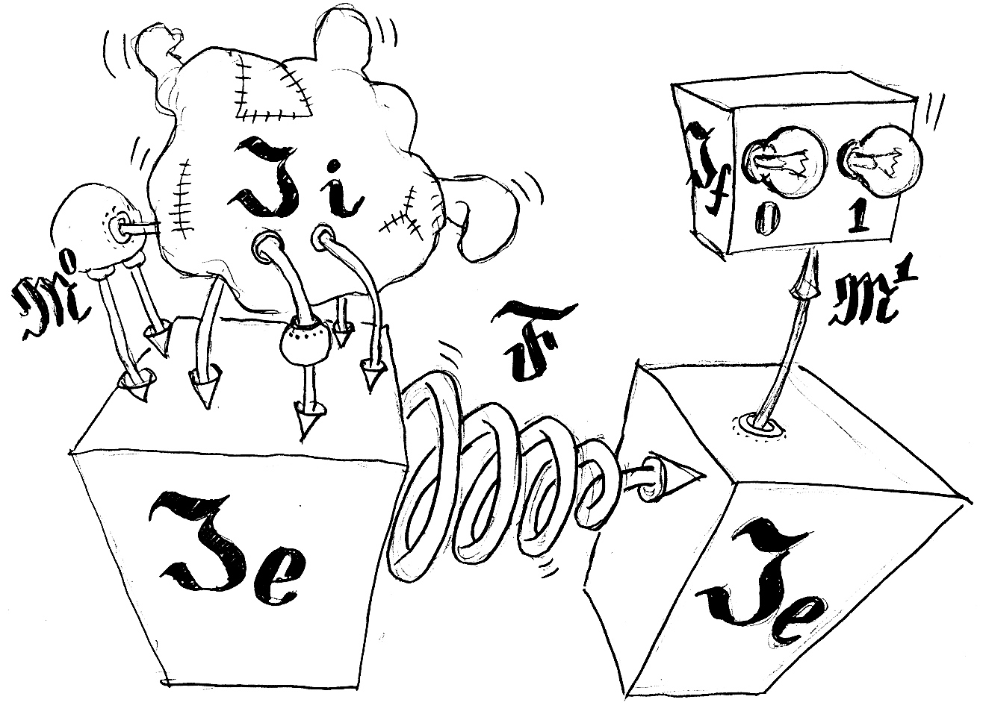
Overfitting and generalization ability of data mining models

Slide 2
Overview
Generalization ability: definition
Justification:
Data mining could be useful in Search
Demo: overfitting always happens
Mathematical frameworks
Statistical learning theory (SLT)
Computational Learning Theory? (COLT)
Combinatorial learning theory

Slide 3

Alexander Frey
Forecsys company
Forecasting and recognition
systems
Search Core Test team in FAST
Master’s thesis: “Exact bounds of overfitting probability for symmetric sets of predictors”

Slide 4
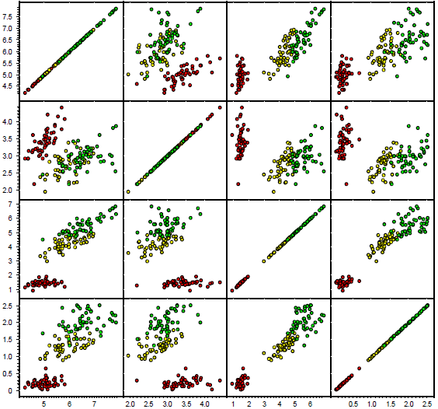
Classification task
Sepal length Sepal width Petal length Petal width
Example:
Iris flowers classification
3 values of target class
150 items in dataset (sample)
4 features
UCI Machine Learning Repository
Sepal length Sepal width Petal length Petal width

Slide 5
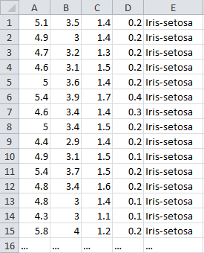
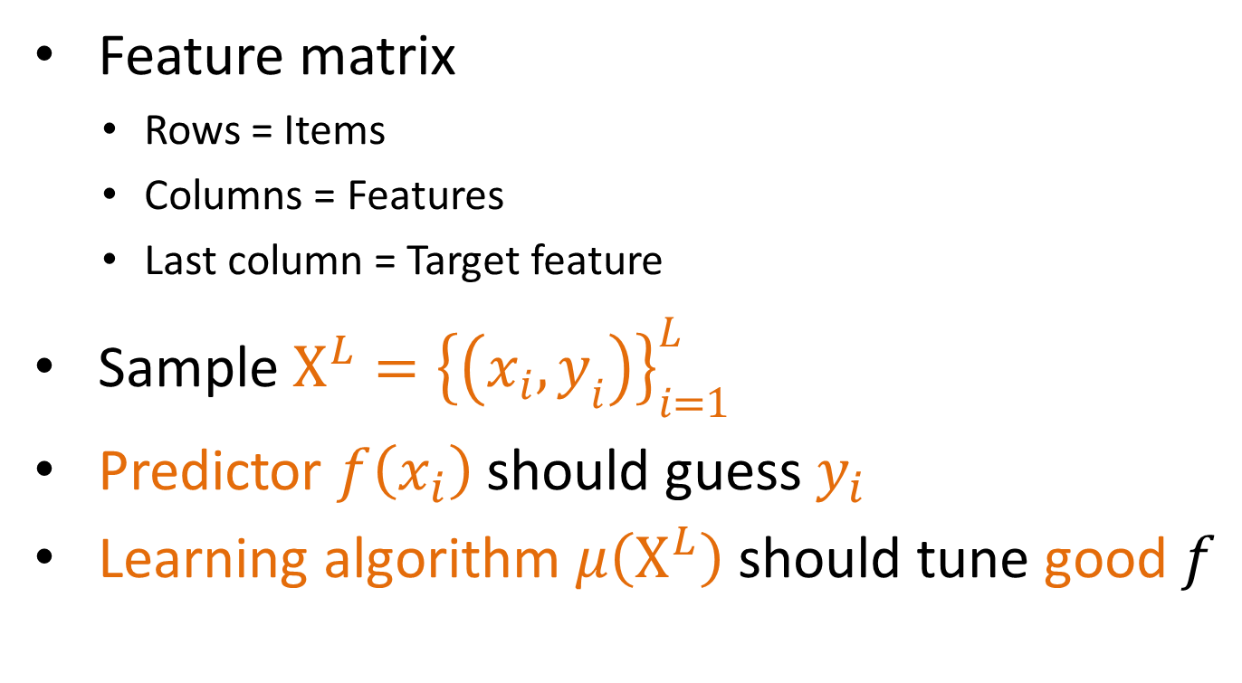
Classification task
Feature matrix
Rows = Items
Columns = Features
Last column = Target feature
Sample $X^{L}={\left\{\left(x_{i},y_{i}\right)\right\}}_{i=1}^{L}$
Predictor $f\left(x_{i}\right)$ should guess $y_{i}$
Learning algorithm $μ\left(X^{L}\right)$ should tune good $f$

Slide 6
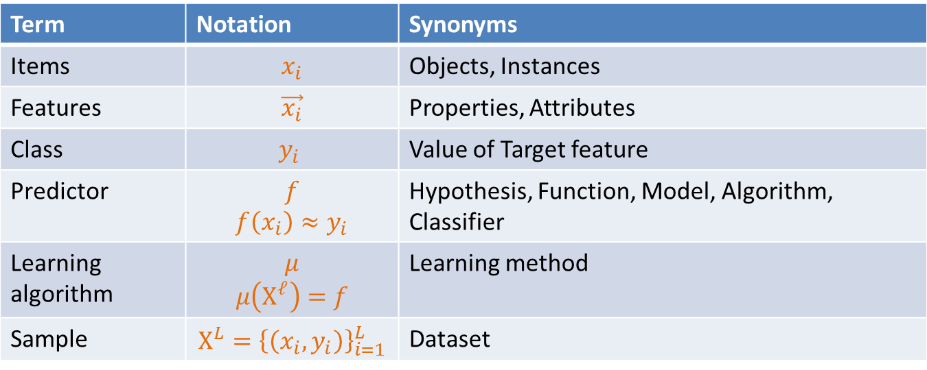
Classification task
Term | Notation | Synonyms
Items | $$x_{i}$$ | Objects, Instances
Features | $$\vec{x_{i}}$$ | Properties, Attributes
Class | $$y_{i}$$ | Value of Target feature
Predictor | $$f$$ $$f\left(x_{i}\right)≈y_{i}$$ | Hypothesis, Function, Model, Algorithm, Classifier
Learning algorithm | $$μ$$ $$μ\left(X^{ℓ}\right)=f$$ | Learning method
Sample | $$X^{L}={\left\{\left(x_{i},y_{i}\right)\right\}}_{i=1}^{L}$$ | Dataset

Slide 7
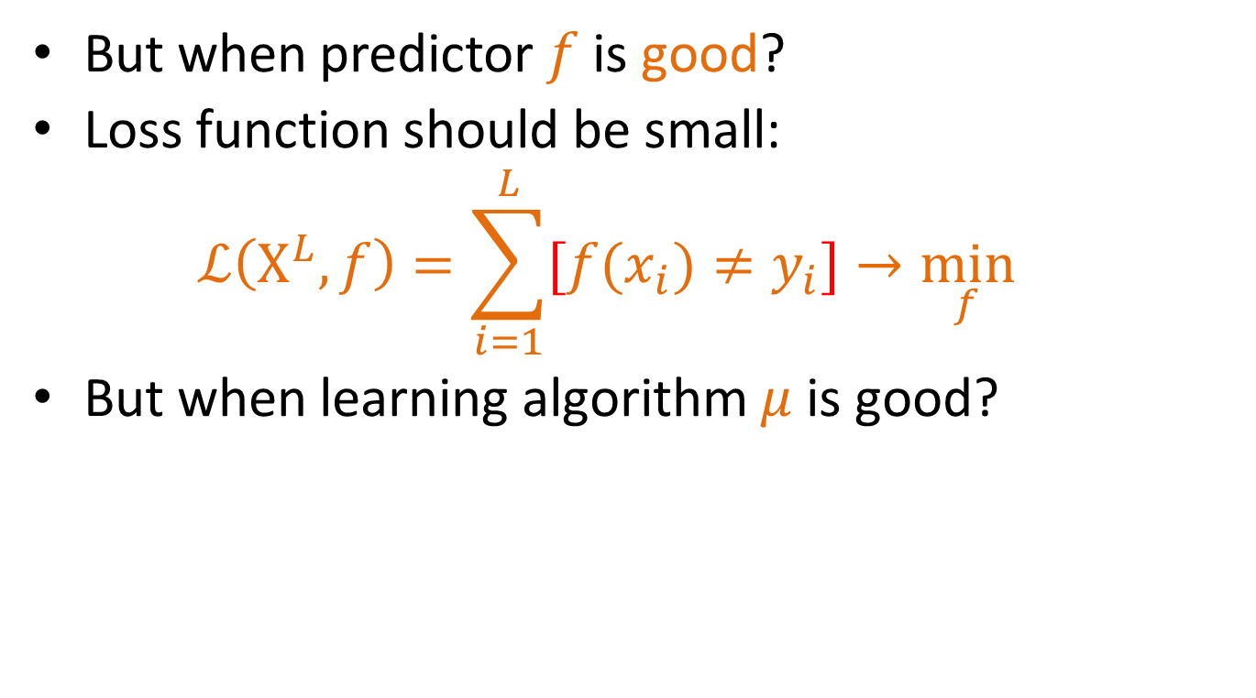
Classification Loss Function
But when predictor $f$ is good?
Loss function should be small:
$$ℒ\left(X^{L},f\right)=\sum_{i=1}^{L}{[f(x_{i})≠y_{i}]→\min_{f}{}}$$
But when learning algorithm $μ$is good?
Average loss on test data should be small:
$$\sum_{X^{L}=X^{ℓ}⨆X^{k}}^{L}{ℒ\left(X^{k},μ(X^{ℓ})\right)→\min_{μ}{}}$$

Slide 8
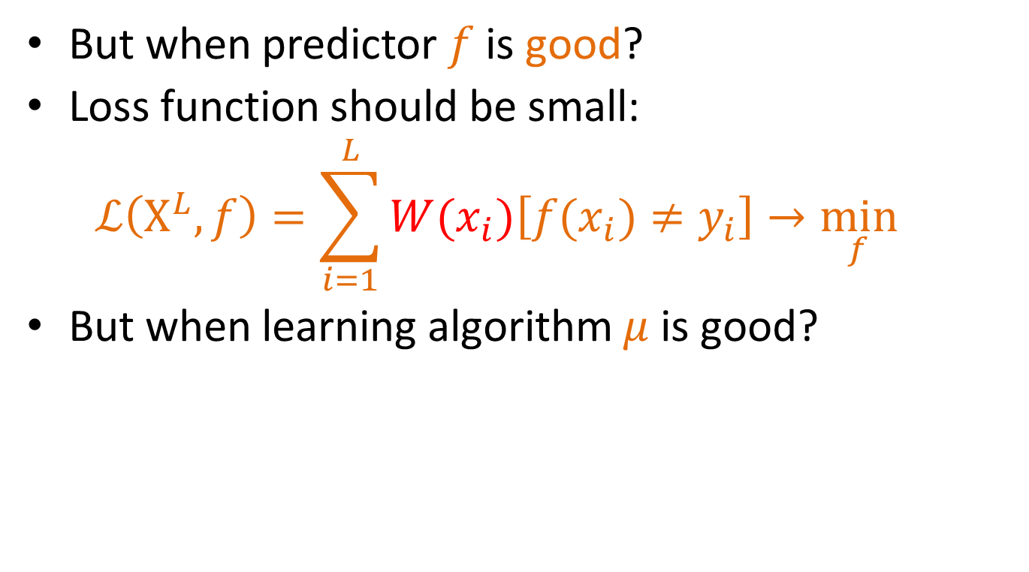
Classification Loss Function
But when predictor $f$ is good?
Loss function should be small:
$$ℒ\left(X^{L},f\right)=\sum_{i=1}^{L}{W(x_{i})\left[f(x_{i})≠y_{i}\right]→\min_{f}{}}$$
But when learning algorithm $μ$is good?
Average loss on test data should be small:
$$\sum_{X^{L}=X^{ℓ}⨆X^{k}}^{L}{ℒ\left(X^{k},μ(X^{ℓ})\right)→\min_{μ}{}}$$

Slide 9
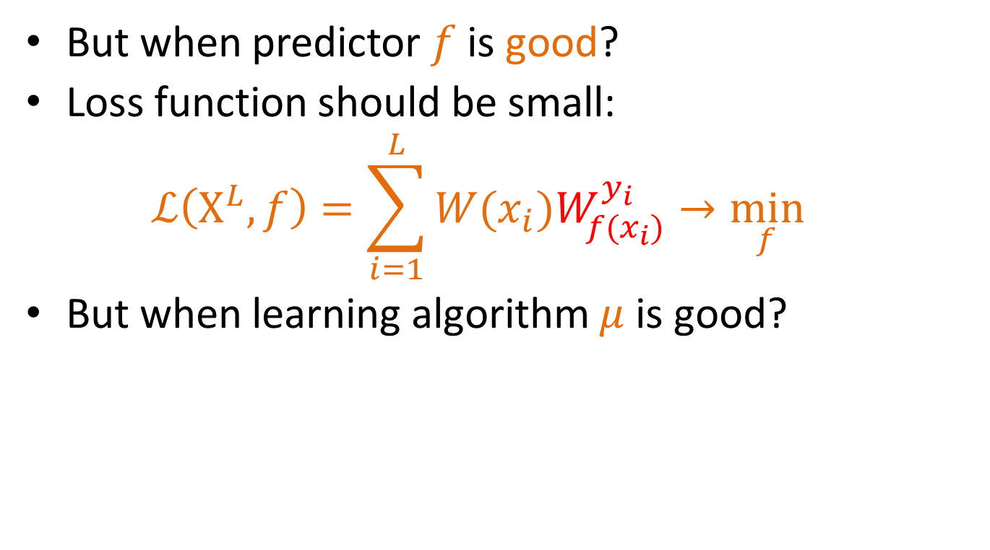
Classification Loss Function
But when predictor $f$ is good?
Loss function should be small:
$$ℒ\left(X^{L},f\right)=\sum_{i=1}^{L}{W(x_{i})W_{f(x_{i})}^{y_{i}}→\min_{f}{}}$$
But when learning algorithm $μ$is good?
Average loss on test data should be small:
$$\sum_{X^{L}=X^{ℓ}⨆X^{k}}^{L}{ℒ\left(X^{k},μ(X^{ℓ})\right)→\min_{μ}{}}$$

Slide 10
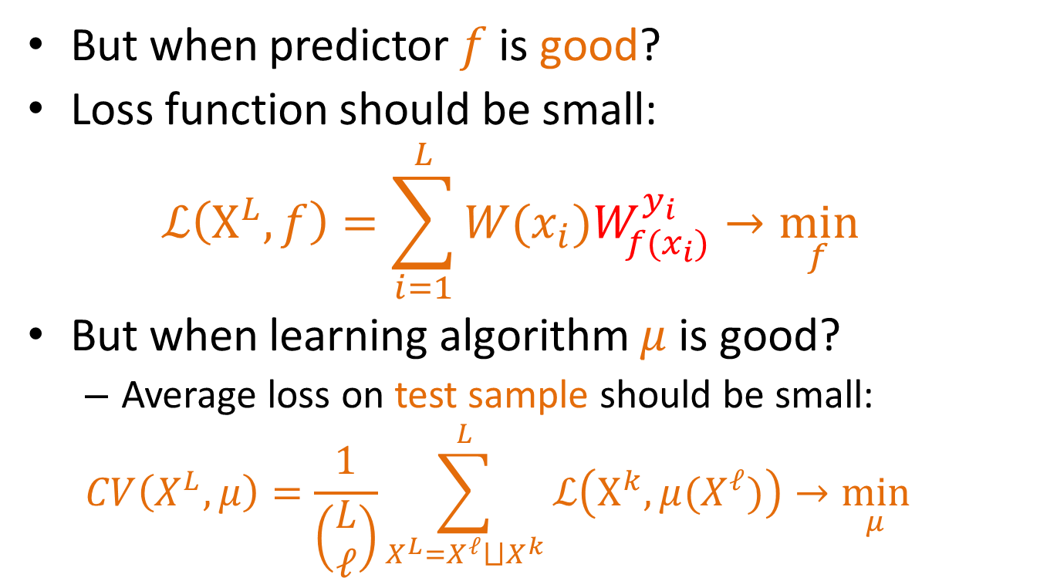
Classification Loss Function
But when predictor $f$ is good?
Loss function should be small:
$$ℒ\left(X^{L},f\right)=\sum_{i=1}^{L}{W(x_{i})W_{f(x_{i})}^{y_{i}}→\min_{f}{}}$$
But when learning algorithm $μ$is good?
Average loss on test sample should be small:
$$CV\left(X^{L},μ\right)=\frac{1}{\left(\begin{matrix}L \\ ℓ\end{matrix}\right)}\sum_{X^{L}=X^{ℓ}⨆X^{k}}^{L}{ℒ\left(X^{k},μ(X^{ℓ})\right)→\min_{μ}{}}$$

Slide 11
Generalization ability
is an ability of learning algorithm to tune predictors, that not only performs well on training dataset, but that are also capable of making valuable predictions on test dataset that was completely unavailable during training stage.

Slide 12
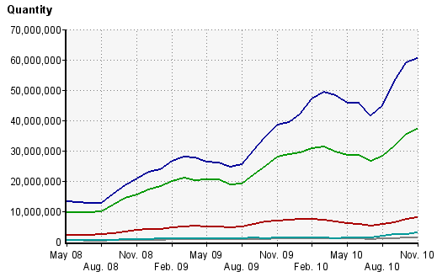

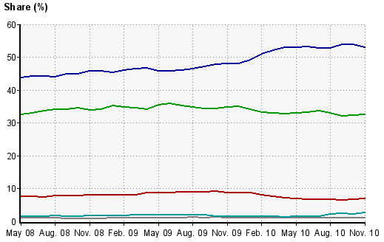
Yandex.ru vs Google.ru
Most popular Russian Web-Search Provider
http://www.liveinternet.ru/stat/ru/searches.html?period=month
Yandex school of data processing
L2R Competition
http://imat2009.yandex.ru/en
Data Mining courses from top Russian scientists

Slide 13
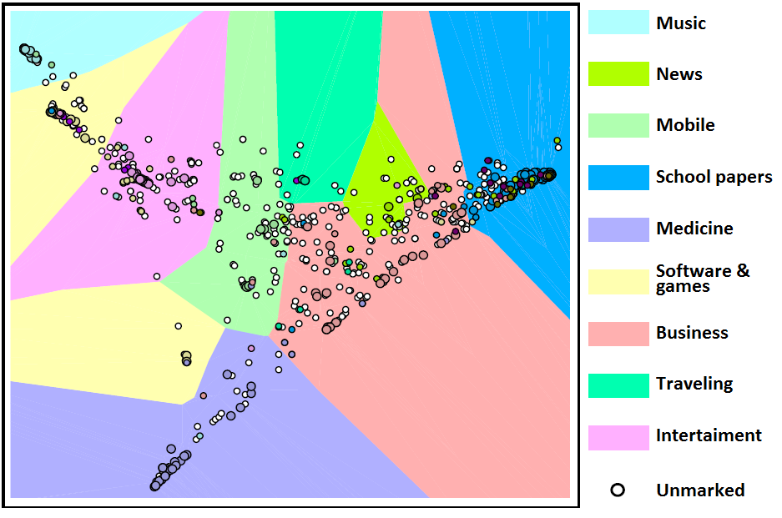
Similarity map of internet websites.
Dataset provided by Yandex company was about visiting 129 600 websites by 14606 users.
Only 1000 most popular websites are displayed on the map.
Among them 400 websites were manually categorized to one of nine classes.
But this information was unavailable for algorithm that calculates point coordinates on the map.
It was used only to point items and background into different colors.

Slide 15
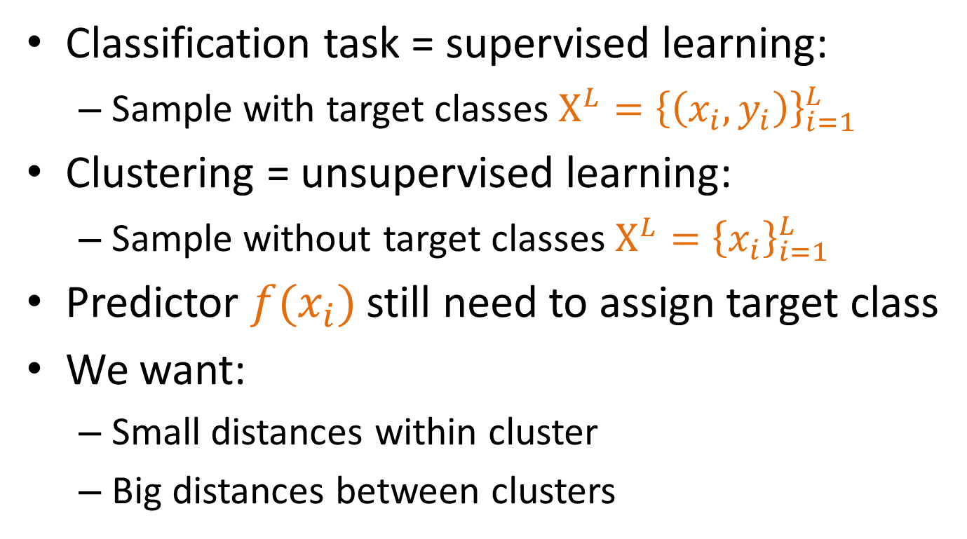
Clustering Task
Classification task = supervised learning:
Sample with target classes $X^{L}={\left\{\left(x_{i},y_{i}\right)\right\}}_{i=1}^{L}$
Clustering = unsupervised learning:
Sample without target classes $X^{L}={\left\{x_{i}\right\}}_{i=1}^{L}$
Predictor $f(x_{i})$ still need to assign target class
We want:
Small distances within cluster
Big distances between clusters

Slide 16
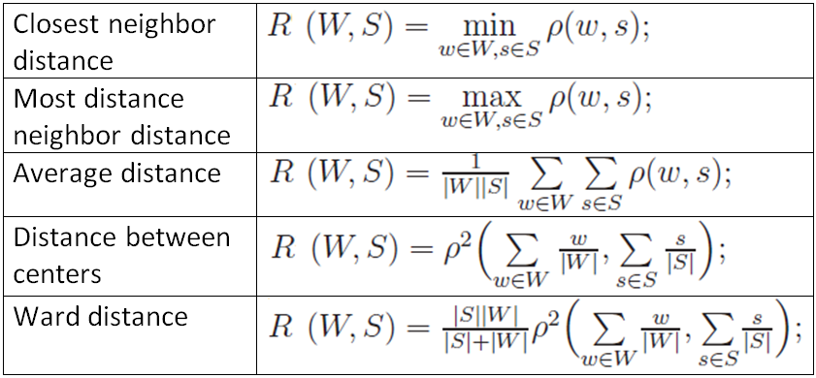
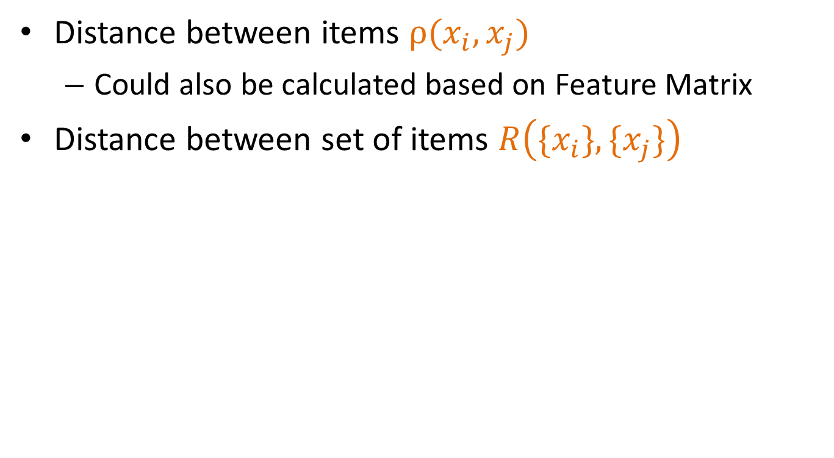
Clustering Loss Function
Distance between items $ρ(x_{i},x_{j})$
Could also be calculated based on Feature Matrix
Distance between set of items $R\left(\{x_{i}\},\{x_{j}\}\right)$

Slide 17
Mutual clustering
Online movie shop problem:
User bought “Gone with the wind”. Is it reasonable to propose him to buy “Titanic”?
Quality: consistency
Users are similar if they are watching similar movies
Movies are similar if they are watched by similar users

Slide 18
Mutual clustering
Simultaneous clustering of users and resources that users are interested in
Quality measure: consistency between metrics on user’s space and resource’s space
Users are similar if they are interested in similar resources
Resources are similar if similar users are interested in this resources

Slide 19
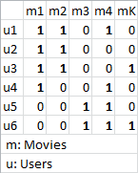
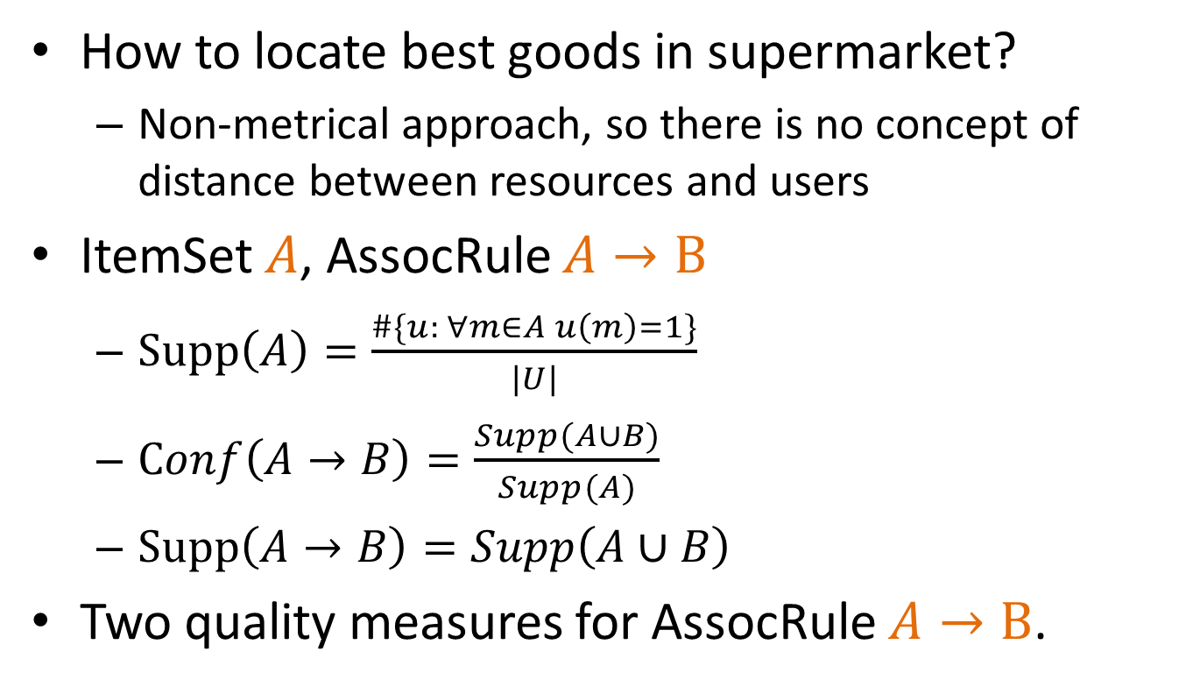
Association rules mining
How to locate best goods in supermarket?
Non-metrical approach, so there is no concept of distance between resources and users
ItemSet $A$, AssocRule $A→B$
$Supp\left(A\right)=\frac{\#\{u: ∀m∈A u\left(m\right)=1\}}{|U|}$
$Conf\left(A→B\right)=\frac{Supp(A∪B)}{Supp(A)}$
$Supp\left(A→B\right)=Supp\left(A∪B\right)$
Two quality measures for AssocRule $A→B$.

Slide 20
Learning to Rank
How to evaluate relevancy mark?
Precision@N / MAP / nDCG / Click through rate
Datasets are pretty expensive
No UCI reposiroty
LETOR database from Microsoft
*** from Yahoo reported as 2 million USD to collect
TREC competition [paid, unless you are participant]
***

Slide 21
Putting it all together:
Field | Data to learn from | Example of Loss function
Classification | Items feature matrix and target classes | Weighted amount of errors
Regression |  | Mean square difference
Clustering | Items feature matrix, or pairwise distances | Average distance between clusters
Mutual clustering | Binary matrix of transactions | Consistency between metric on users and metric on resources
Association rules mining |  | Convolution of support and confidence
Learning to rank | {document, query, relevancy} | Precision@N, MAP, nDCG, Click through rate
Everywhere ☺ |  | How much money did our prediction model save to customer? ($$$)

Slide 22
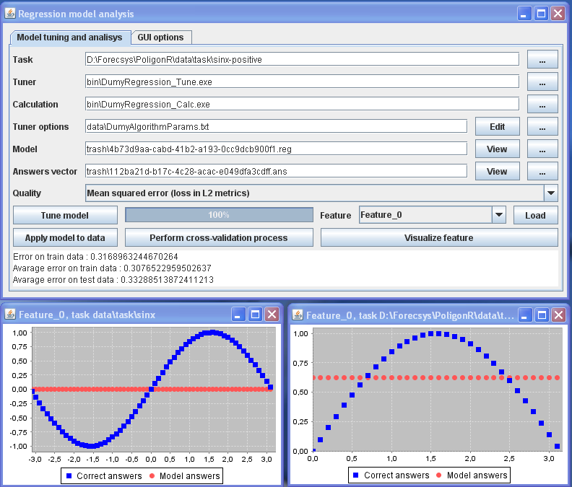

Slide 23
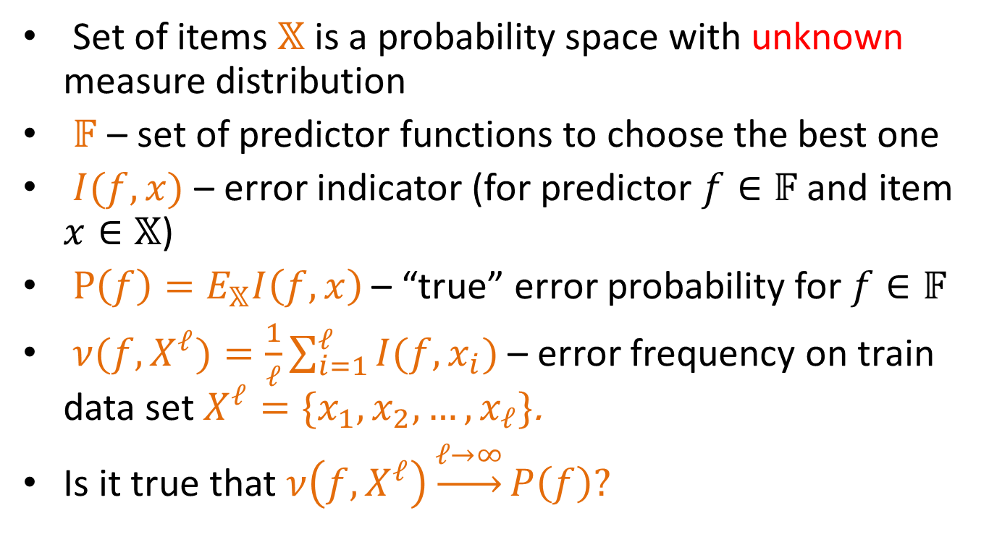
Statistical Learning Theory (SLT)
Set of items $𝕏$ is a probability space with unknown measure distribution
$𝔽$ – set of predictor functions to choose the best one
$I(f,x)$ – error indicator (for predictor $f∈𝔽$ and item $x∈𝕏$)
$P\left(f\right)=E_{𝕏}I\left(f,x\right)$ – “true” error probability for $f∈𝔽$
$ν(f,X^{ℓ})=\frac{1}{ℓ}\sum_{i=1}^{ℓ}{I(f,x_{i})}$ – error frequency on train data set $X^{ℓ}=\{x_{1},x_{2},…,x_{ℓ}\}$.
Is it true that$ν\left(f,X^{ℓ}\right)\underset{→}{ℓ→∞}P\left(f\right)?$

Slide 24
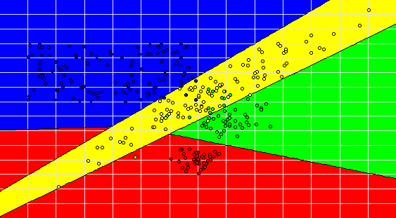
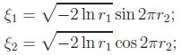

Support Vector Machine (SVM) Train Sample
r1, r2 – random variables with uniform distribution on [0,1]

Slide 25
Support Vector Machine (SVM) Train Sample

Slide 26

Support Vector Machine (SVM) Test Sample

Slide 27
Support Vector Machine (SVM) Train Sample

Slide 28
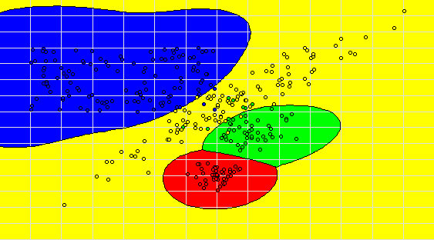
SVM with Radial Basis Functions Train Sample

Slide 29
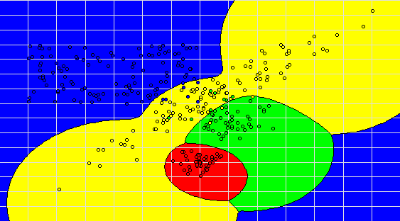
Probability distribution evaluation Train Sample

Slide 30
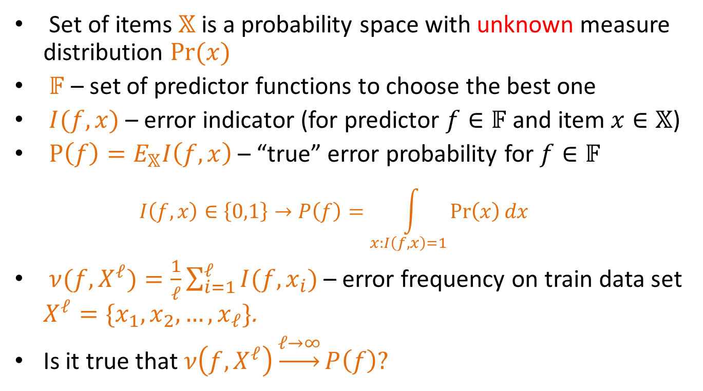
Statistical Learning Theory (SLT)
Set of items $𝕏$ is a probability space with unknown measure distribution $Pr⁡(x)$
$𝔽$ – set of predictor functions to choose the best one
$I(f,x)$ – error indicator (for predictor $f∈𝔽$ and item $x∈𝕏$)
$P\left(f\right)=E_{𝕏}I\left(f,x\right)$ – “true” error probability for $f∈𝔽$
$$I\left(f,x\right)∈\left\{0,1\right\}→P\left(f\right)=\int_{x:I\left(f,x\right)=1}{\operatorname{Pr}\left(x\right)dx}$$
$ν(f,X^{ℓ})=\frac{1}{ℓ}\sum_{i=1}^{ℓ}{I(f,x_{i})}$ – error frequency on train data set $X^{ℓ}=\{x_{1},x_{2},…,x_{ℓ}\}$.
Is it true that$ν\left(f,X^{ℓ}\right)\underset{→}{ℓ→∞}P\left(f\right)?$

Slide 31
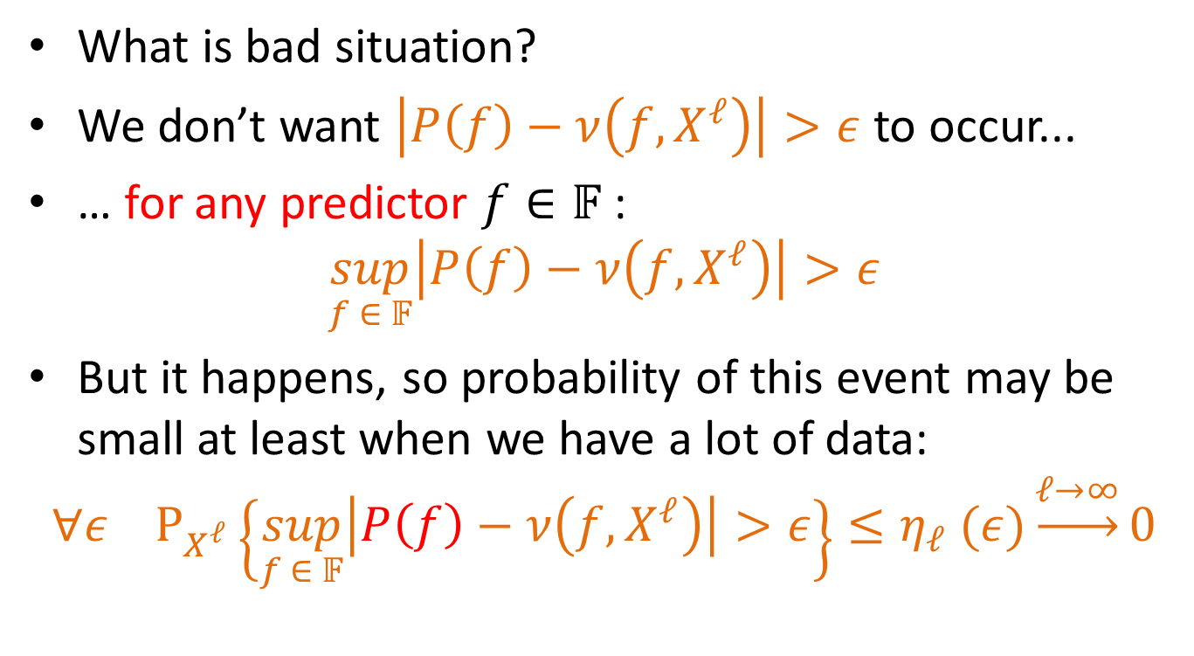
Statistical Learning Theory (SLT)
What is bad situation?
We don’t want $\left|P\left(f\right)−ν\left(f,X^{ℓ}\right)\right|>ε$ to occur...
… for any predictor $f∈𝔽$ :
$$\sup_{f ∈ 𝔽}\left|P\left(f\right)−ν\left(f,X^{ℓ}\right)\right|>ε$$
But it happens, so probability of this event may be small at least when we have a lot of data:
$$∀ε{ P}_{X^{ℓ}}\left\{\sup_{f ∈ 𝔽}\left|P\left(f\right)−ν\left(f,X^{ℓ}\right)\right|>ε\right\}≤η_{ℓ} (ε)\underset{→}{ℓ→∞}0$$

Slide 32
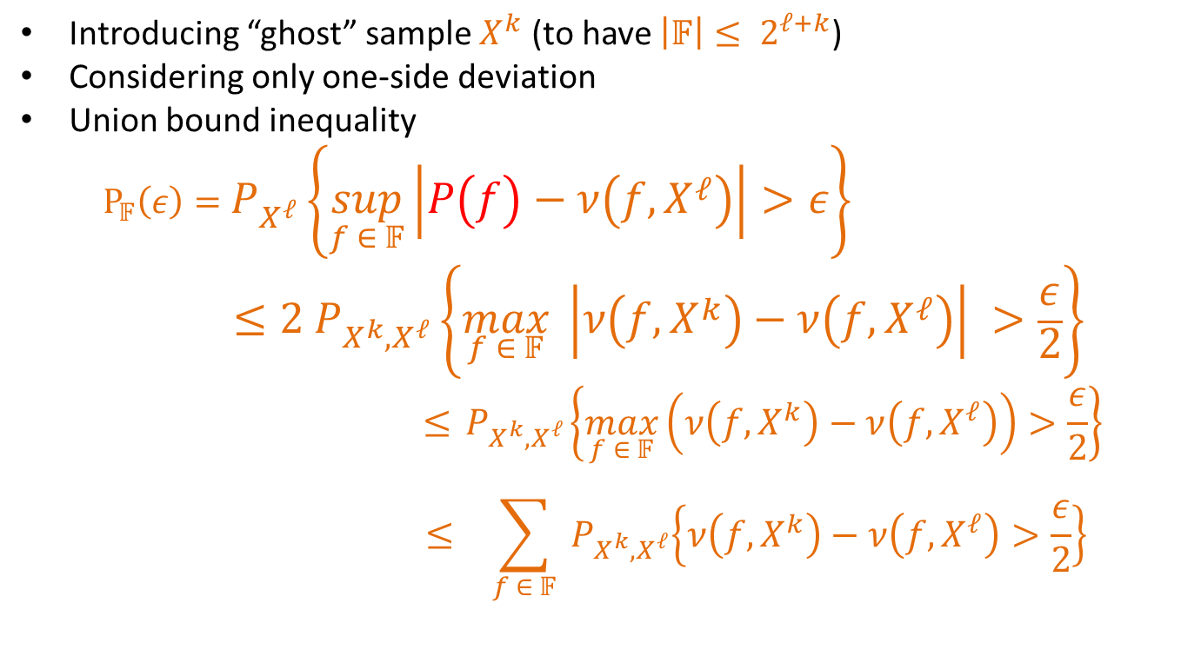
Statistical Learning Theory (SLT)
Introducing “ghost” sample $X^{k}$ (to have $\left|𝔽\right|≤ 2^{ℓ+k}$)
Considering only one-side deviation
Union bound inequality
$$P_{𝔽}\left(ε\right)=P_{X^{ℓ}}\left\{\sup_{f ∈ 𝔽}\left|P\left(f\right)−ν\left(f,X^{ℓ}\right)\right|>ε\right\}≤{2 P}_{X^{k},X^{ℓ}}\left\{\max_{f ∈ 𝔽}{ \left|ν\left(f,X^{k}\right)−ν\left(f,X^{ℓ}\right)\right| >\frac{ε}{2}}\right\}$$
$$≤{ P}_{X^{k},X^{ℓ}}\left\{\max_{f ∈ 𝔽}\left(ν\left(f,X^{k}\right)−ν\left(f,X^{ℓ}\right)\right)>\frac{ε}{2}\right\}$$
$$≤1\sum_{f ∈ 𝔽}{{ P}_{X^{k},X^{ℓ}}\left\{ν\left(f,X^{k}\right)−ν\left(f,X^{ℓ}\right)>\frac{ε}{2}\right\} }$$

Slide 33
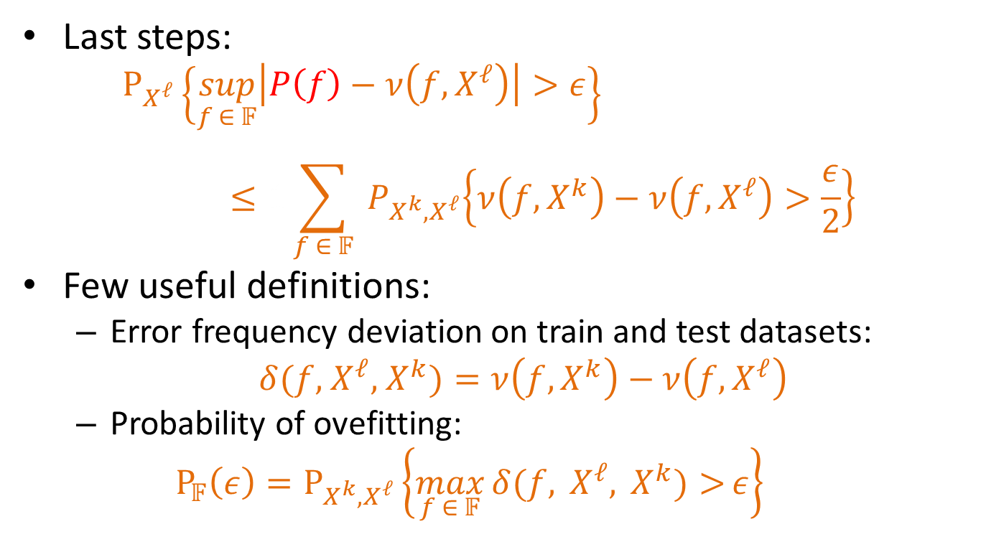
Statistical Learning Theory (SLT)
Last steps:
$$P_{X^{ℓ}}\left\{\sup_{f ∈ 𝔽}\left|P\left(f\right)−ν\left(f,X^{ℓ}\right)\right|>ε\right\}≤1\sum_{f ∈ 𝔽}{{ P}_{X^{k},X^{ℓ}}\left\{ν\left(f,X^{k}\right)−ν\left(f,X^{ℓ}\right)>\frac{ε}{2}\right\} }$$
Few useful definitions:
Error frequency deviation on train and test datasets:
$δ(f,$ $X^{ℓ},$ $X^{k})=ν\left(f,X^{k}\right)−ν\left(f,X^{ℓ}\right)$
Probability of ovefitting:
$${P_{𝔽}\left(ε\right)=P}_{X^{k},X^{ℓ}}\left\{\max_{f ∈ 𝔽}{δ(f, X^{ℓ}, X^{k})>}ε\right\}$$

Slide 34
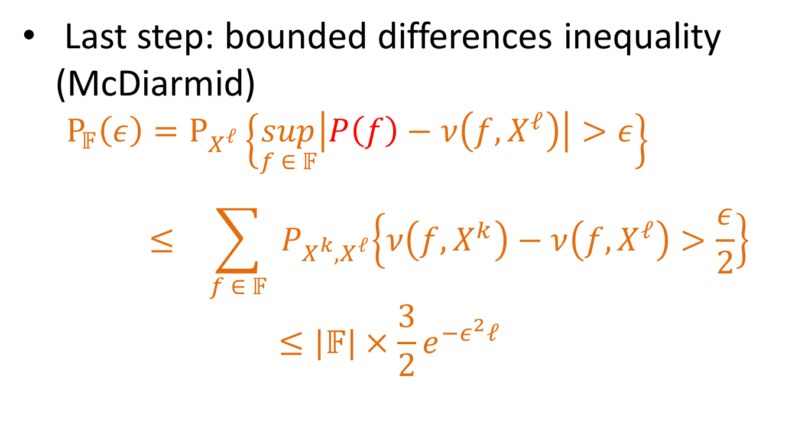
Statistical Learning Theory (SLT)
Last step: bounded differences inequality (McDiarmid)
$$P_{𝔽}\left(ε\right)=P_{X^{ℓ}}\left\{\sup_{f ∈ 𝔽}\left|P\left(f\right)−ν\left(f,X^{ℓ}\right)\right|>ε\right\}≤1\sum_{f ∈ 𝔽}{{ P}_{X^{k},X^{ℓ}}\left\{ν\left(f,X^{k}\right)−ν\left(f,X^{ℓ}\right)>\frac{ε}{2}\right\} }$$
$$≤|𝔽|×\frac{3}{2}e^{−ε^{2}ℓ}$$

Slide 35
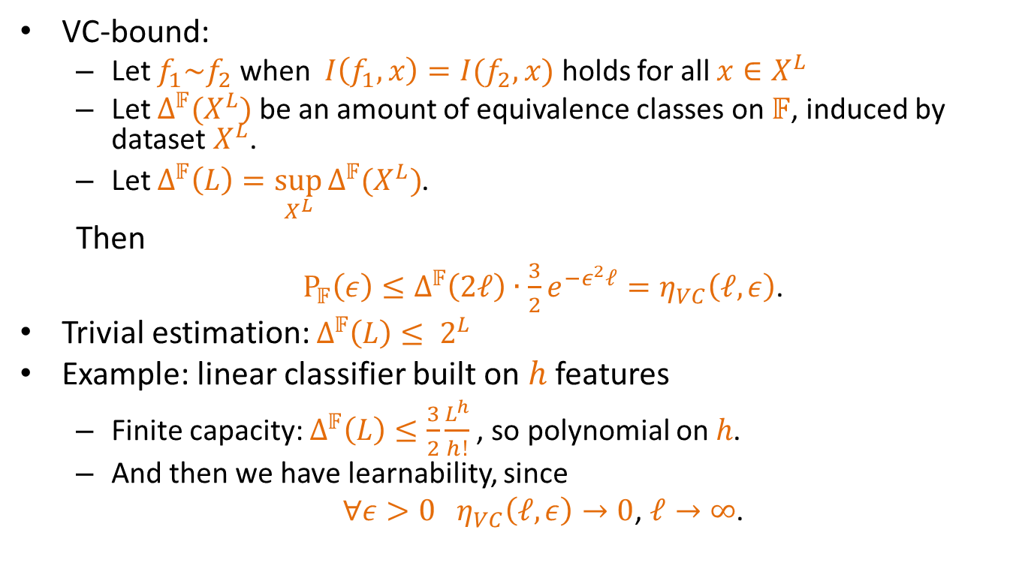
Statistical Learning Theory (SLT)
VC-bound:
Let $f_{1}\sim f_{2}$ when $I\left(f_{1},x\right)=I(f_{2},x)$ holds for all $x∈X^{L}$
Let $Δ^{𝔽}(X^{L})$ be an amount of equivalence classes on $𝔽$, induced by dataset $X^{L}$.
Let $Δ^{𝔽}\left(L\right)=\sup_{X^{L}}{Δ^{𝔽}(X^{L})}$.
Then
$P_{𝔽}\left(ε\right)≤Δ^{𝔽}\left(2ℓ\right)$ $∙$ $\frac{3}{2}e^{−ε^{2}ℓ}=η_{VC}\left(ℓ,ε\right)$.
Trivial estimation: $Δ^{𝔽}\left(L\right)≤ 2^{L}$
Example: linear classifier built on $h$ features
Finite capacity: $Δ^{𝔽}\left(L\right)≤\frac{3}{2}\frac{L^{h}}{h!}$, so polynomial on $h\text{.}$
And then we have learnability, since
$∀ε>0 η_{VC}\left(ℓ,ε\right)→0$, $ℓ→∞$.

Slide 36
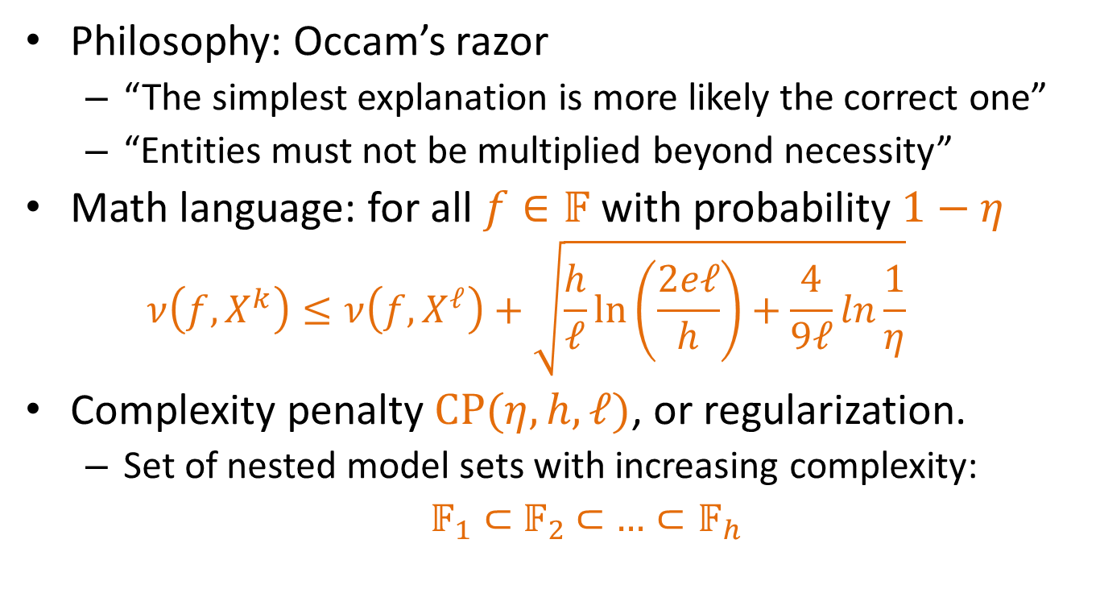
Statistical Learning Theory (SLT)
Philosophy: Occam’s razor
“The simplest explanation is more likely the correct one”
“Entities must not be multiplied beyond necessity”
Math language: for all $f∈𝔽$ with probability $1−η$
$$ν\left(f,X^{k}\right)≤ν\left(f,X^{ℓ}\right)+\sqrt{\frac{h}{ℓ}\ln\left(\frac{2eℓ}{h}\right)+\frac{4}{9ℓ}ln\frac{1}{η}}$$
Complexity penalty $CP(η,h,ℓ)$, or regularization.
Set of nested model sets with increasing complexity:
$𝔽_{1}⊂$ $𝔽_{2}$ $⊂$ $…⊂𝔽_{h}$

Slide 37
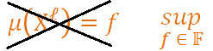
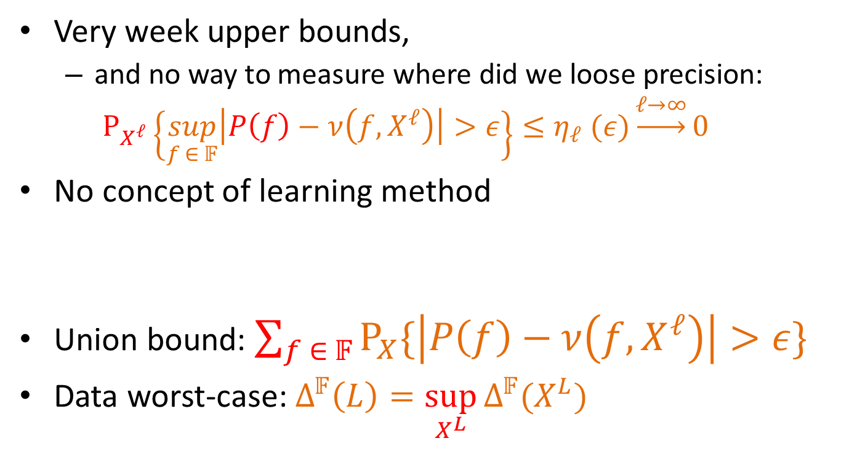
Problems of Statistical Learning Theory
Very week upper bounds,
and no way to measure where did we loose precision:
$$P_{X^{ℓ}}\left\{\sup_{f ∈ 𝔽}\left|P\left(f\right)−ν\left(f,X^{ℓ}\right)\right|>ε\right\}≤η_{ℓ} (ε)\underset{→}{ℓ→∞}0$$
No concept of learning method
Union bound: $\sum_{f ∈ 𝔽}{P_{X}\{\left|P\left(f\right)−ν\left(f,X^{ℓ}\right)\right|>ε\}}$
Data worst-case:$Δ^{𝔽}\left(L\right)=\sup_{X^{L}}{Δ^{𝔽}(X^{L})}$

Slide 38
Problem of Statistical Learning Theory
Too far away from reality!

Slide 39
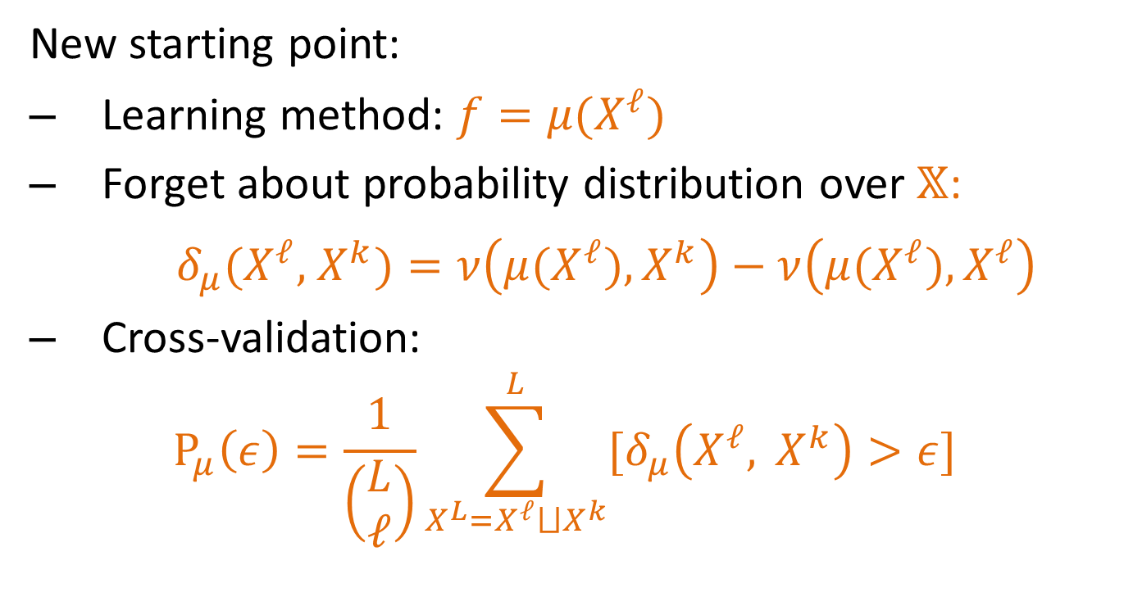
Combinatorial Learning Theory
New starting point:
Learning method: $f=μ(X^{ℓ})$
Forget about probability distribution over $𝕏$:
$δ_{μ}(X^{ℓ},$ $X^{k})=ν\left(μ(X^{ℓ}),X^{k}\right)−ν\left(μ(X^{ℓ}),X^{ℓ}\right)$
Cross-validation:
$$P_{μ}\left(ε\right)=\frac{1}{\left(\begin{matrix}L \\ ℓ\end{matrix}\right)}\sum_{X^{L}=X^{ℓ}⨆X^{k}}^{L}{[δ_{μ}\left(X^{ℓ}, X^{k}\right)>ε] }$$

Slide 40
Combinatorial Learning Theory
New starting point:
Learning method: $f=μ(X^{ℓ})$
Forget about probability distribution over $𝕏$:
$δ_{μ}(X^{ℓ},$ $X^{k})=ν\left(μ(X^{ℓ}),X^{k}\right)−ν\left(μ(X^{ℓ}),X^{ℓ}\right)$
Cross-validation:
$$P_{μ}\left(ε\right)=\frac{1}{\left(\begin{matrix}L \\ ℓ\end{matrix}\right)}\sum_{X^{L}=X^{ℓ}⨆X^{k}}^{L}{[δ_{μ}\left(X^{ℓ}, X^{k}\right)>ε] }$$
P

Slide 41
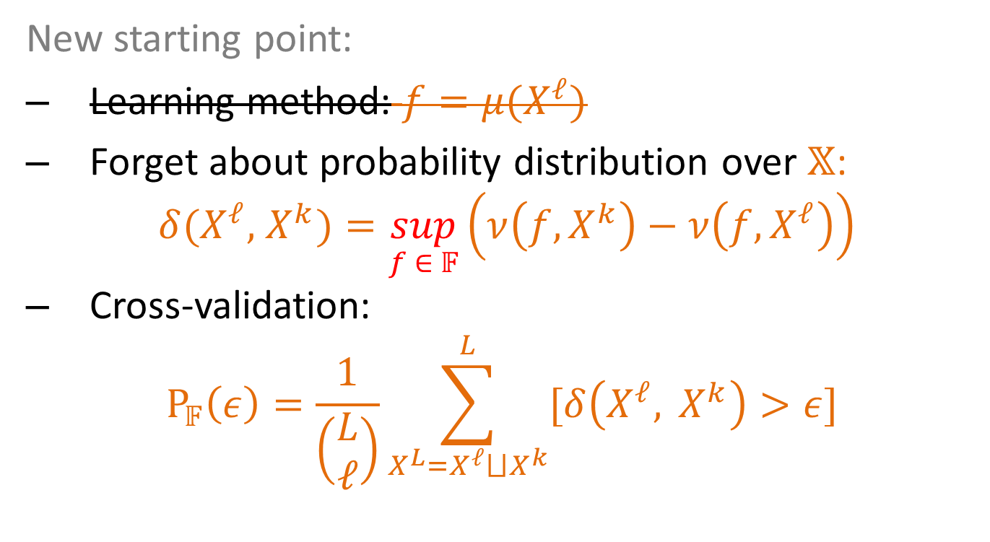
Combinatorial Learning Theory
New starting point:
Learning method: $f=μ(X^{ℓ})$
Forget about probability distribution over $𝕏$:
$δ(X^{ℓ},$ $X^{k})=\sup_{f ∈ 𝔽}\left(ν\left(f,X^{k}\right)−ν\left(f,X^{ℓ}\right)\right)$
Cross-validation:
$$P_{𝔽}\left(ε\right)=\frac{1}{\left(\begin{matrix}L \\ ℓ\end{matrix}\right)}\sum_{X^{L}=X^{ℓ}⨆X^{k}}^{L}{[δ\left(X^{ℓ}, X^{k}\right)>ε]}$$

Slide 42
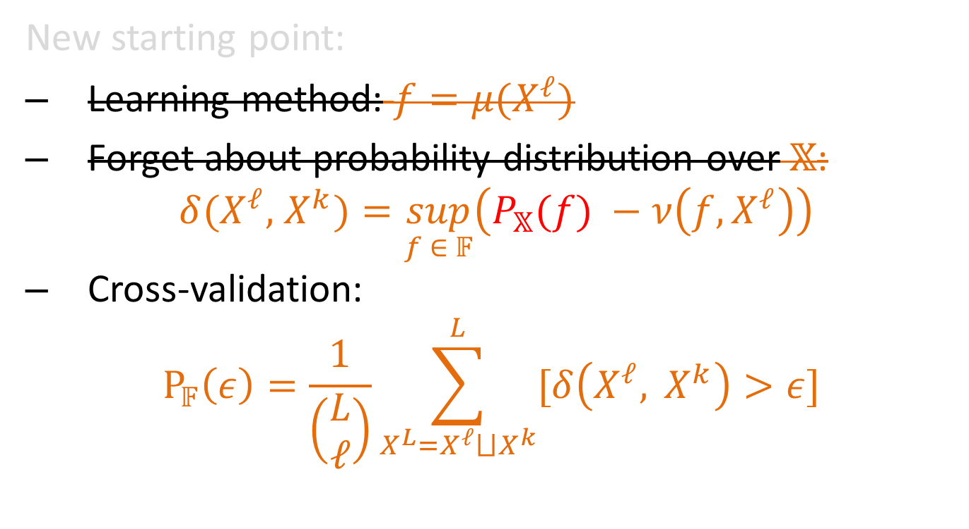
Combinatorial Learning Theory
New starting point:
Learning method: $f=μ(X^{ℓ})$
Forget about probability distribution over$𝕏$:
$δ(X^{ℓ},$ $X^{k})=\sup_{f ∈ 𝔽}\left(P_{𝕏}(f) −ν\left(f,X^{ℓ}\right)\right)$
Cross-validation:
$$P_{𝔽}\left(ε\right)=\frac{1}{\left(\begin{matrix}L \\ ℓ\end{matrix}\right)}\sum_{X^{L}=X^{ℓ}⨆X^{k}}^{L}{[δ\left(X^{ℓ}, X^{k}\right)>ε]}$$

Slide 43
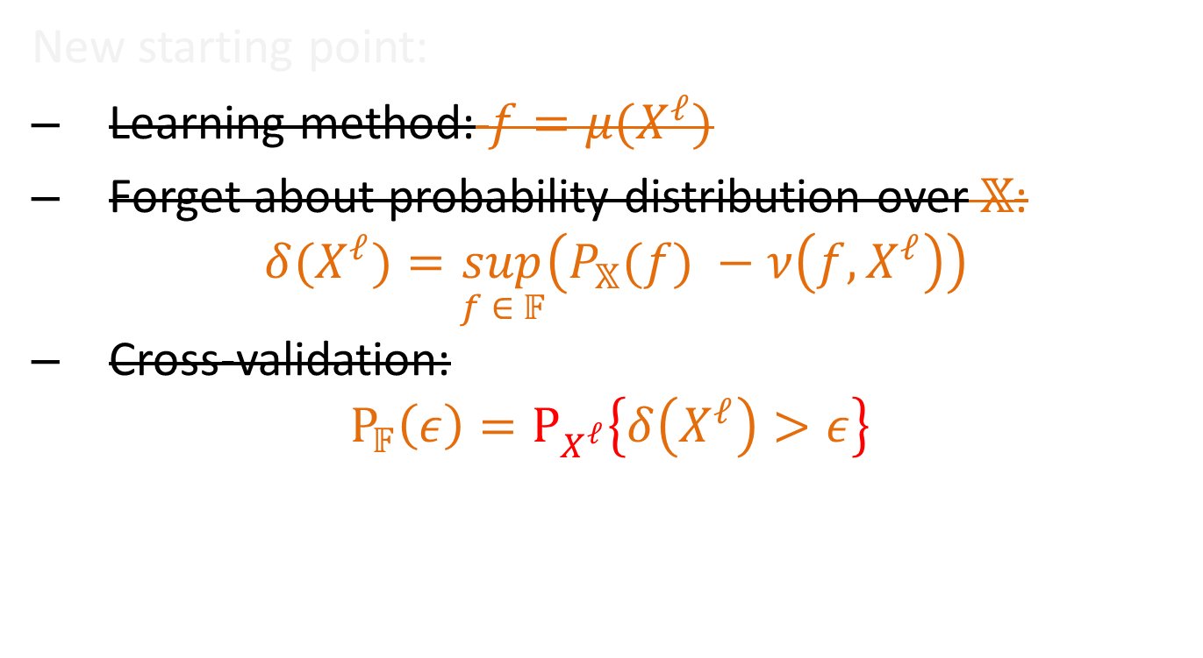
Combinatorial Learning Theory
New starting point:
Learning method: $f=μ(X^{ℓ})$
Forget about probability distribution over$𝕏$:
$δ(X^{ℓ})=\sup_{f ∈ 𝔽}\left(P_{𝕏}(f) −ν\left(f,X^{ℓ}\right)\right)$
Cross-validation:
$$P_{𝔽}\left(ε\right)=P_{X^{ℓ}}\left\{δ\left(X^{ℓ}\right)>ε\right\}$$

Slide 44
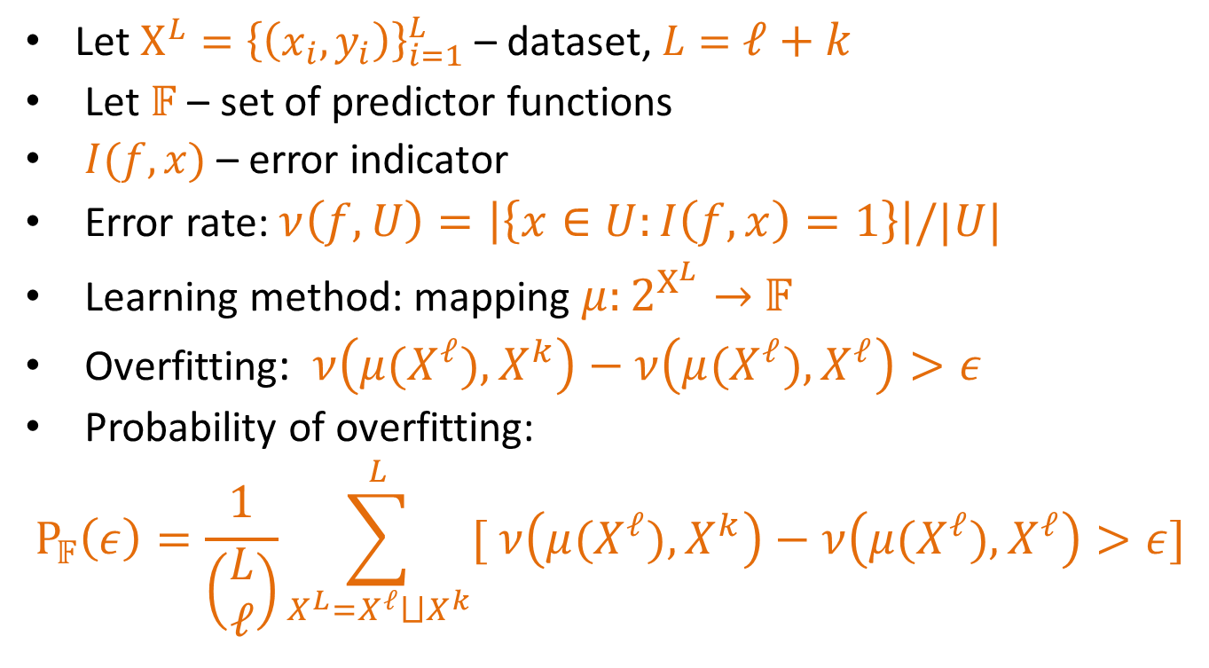
Combinatorial Learning Theory
Let $X^{L}={\left\{\left(x_{i},y_{i}\right)\right\}}_{i=1}^{L}$ – dataset, $L=$ $ℓ+k$
Let $𝔽$ – set of predictor functions
$I(f,x)$ – error indicator
Error rate: $ν\left(f,U\right)=\left|\left\{x∈U:I\left(f,x\right)=1\right\}\right|/|U|$
Learning method: mapping $μ:2^{X^{L}}→$ $𝔽$
Overfitting: $ν\left(μ(X^{ℓ}),X^{k}\right)−ν\left(μ(X^{ℓ}),X^{ℓ}\right)>ε$
Probability of overfitting:
$$P_{𝔽}\left(ε\right)=\frac{1}{\left(\begin{matrix}L \\ ℓ\end{matrix}\right)}\sum_{X^{L}=X^{ℓ}⨆X^{k}}^{L}{[ ν\left(μ(X^{ℓ}),X^{k}\right)−ν\left(μ(X^{ℓ}),X^{ℓ}\right)>ε]}$$
P

Slide 45
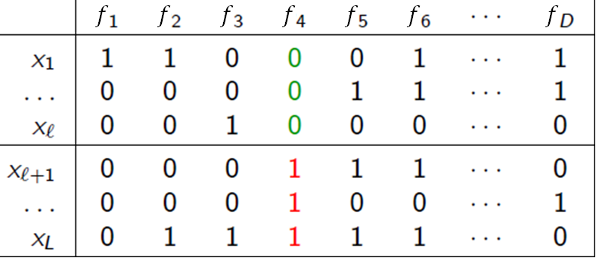
Combinatorial Learning Theory
Learning method: Empirical Risk Minimization

Slide 46
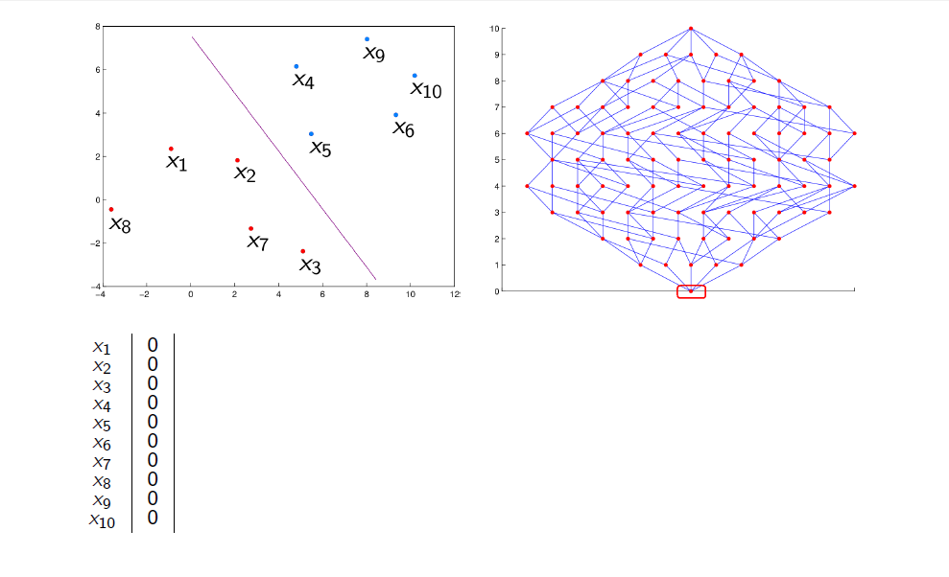

Slide 47
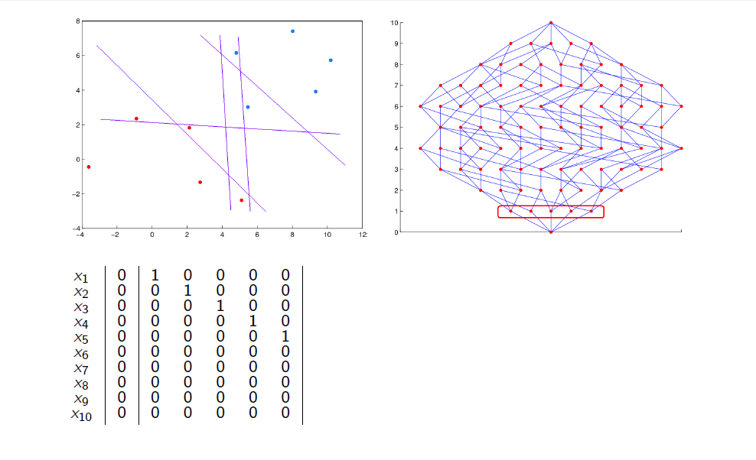

Slide 48
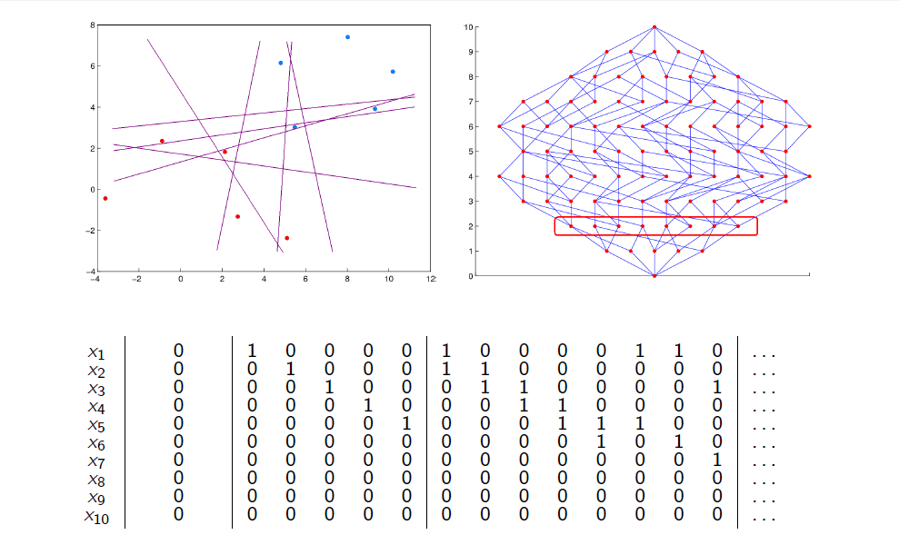

Slide 49
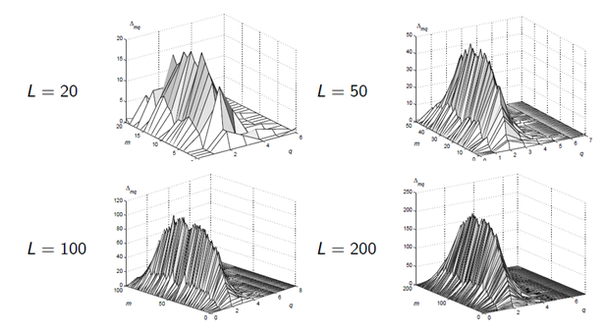
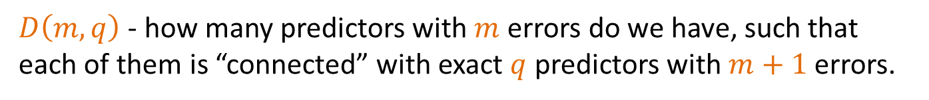
Attributes of connectivity graph
$D\left(m,q\right)$ - how many predictors with $m$ errors do we have, such that each of them is “connected” with exact $q$ predictors with $m+1$ errors.

Slide 50
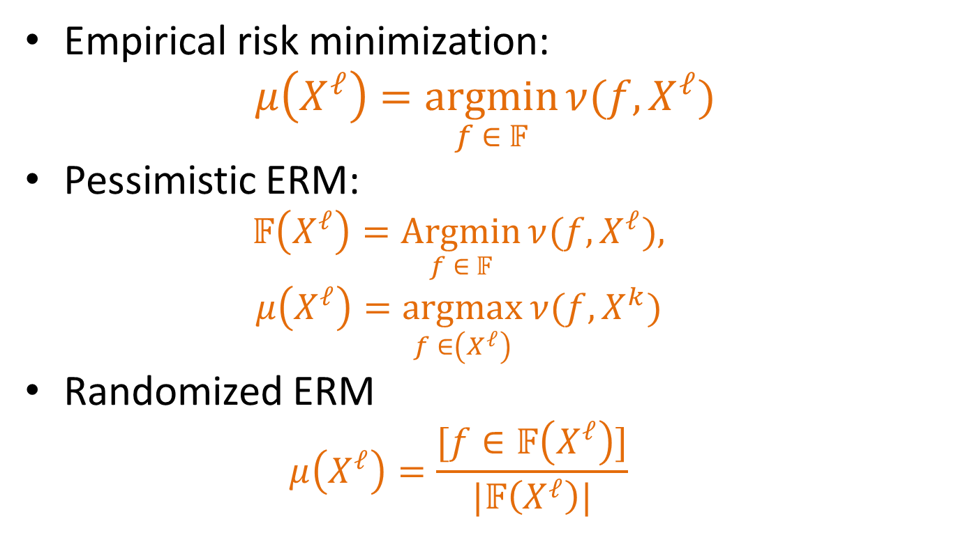
Combinatorial Learning Theory
Empirical risk minimization:
$$μ\left(X^{ℓ}\right)=\underset{f ∈ 𝔽}{argmin}{ν(f,}X^{ℓ})$$
Pessimistic ERM:
$$𝔽\left(X^{ℓ}\right)=\underset{f ∈ 𝔽}{Argmin}{ν(f,}X^{ℓ}),$$
$$μ\left(X^{ℓ}\right)=\underset{f ∈\left(X^{ℓ}\right)}{argmax}{ν(f,}X^{k})$$
Randomized ERM
$$μ\left(X^{ℓ}\right)=\frac{[f∈𝔽\left(X^{ℓ}\right)]}{|𝔽\left(X^{ℓ}\right)|}$$

Slide 51
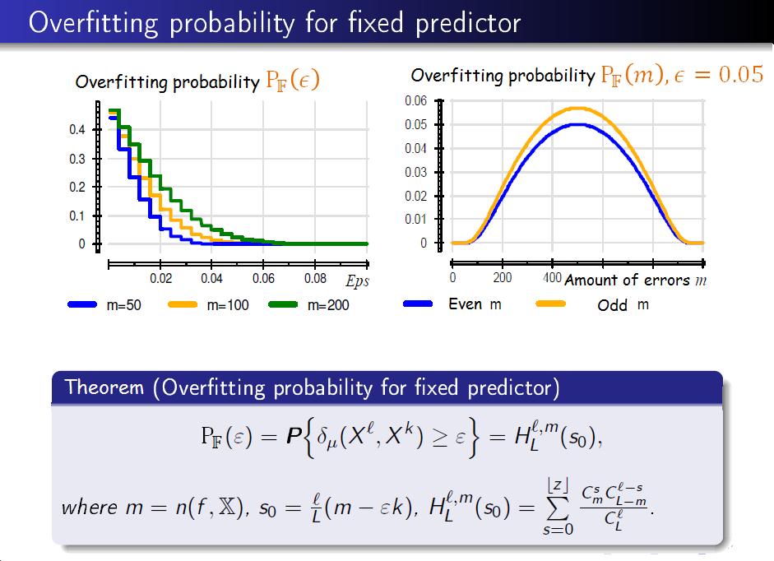

Slide 52
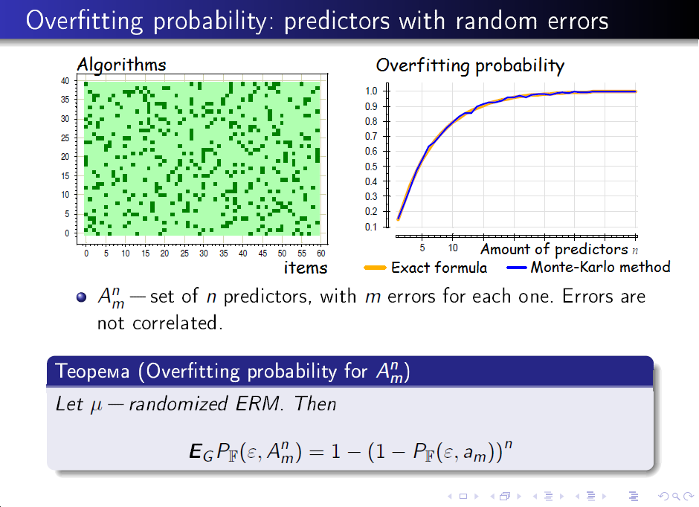

Slide 53
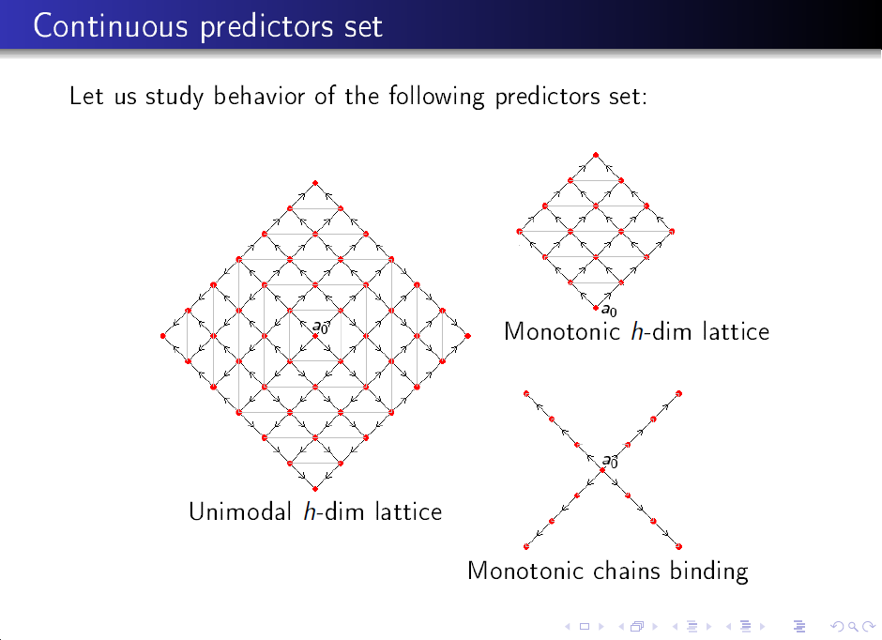

Slide 54
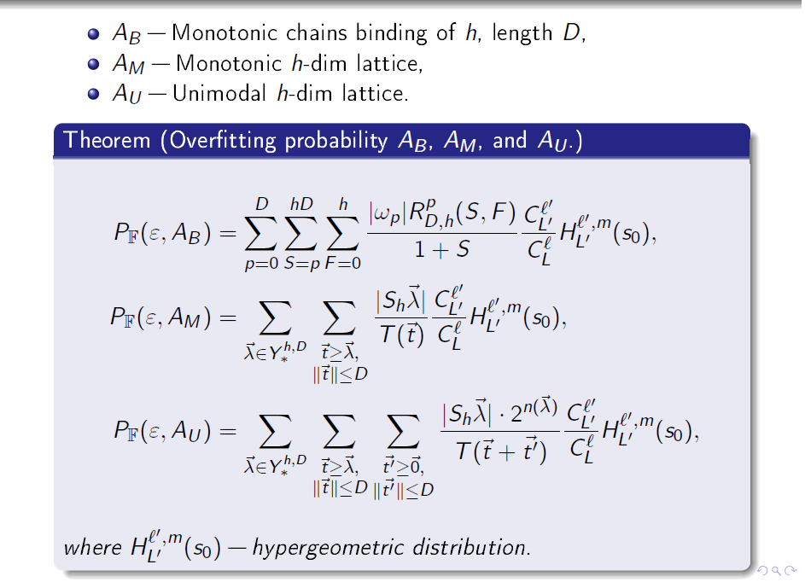

Slide 55
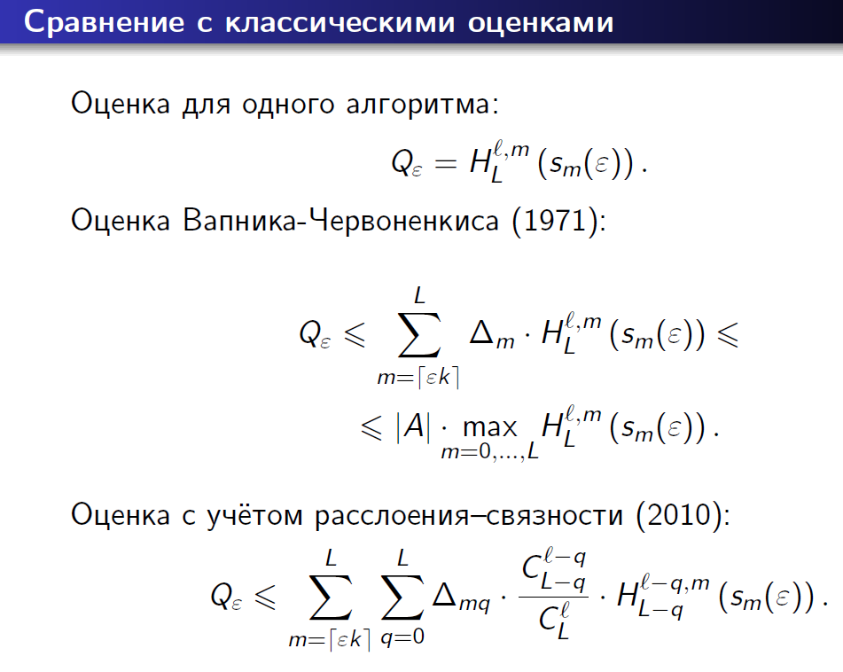
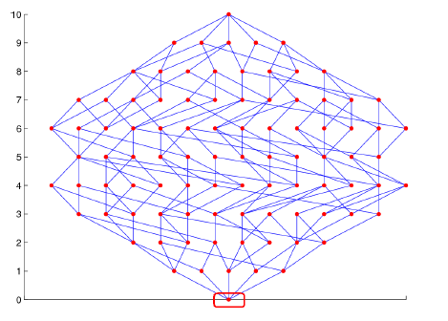

Slide 56


Slide 57


Slide 58


Slide 59

Conclusions about Combinatorial Learning Theory
Exact overfitting probability estimation,
Or tight bounds with a way to measure where did we loose precision:
Concept of learning method
Data-dependent analysis
Connectivity graph on algorithm set

Slide 60
Conclusion
Can we use even more data mining stuff in Search Engine? Probably yes:
State-of-the-art BM25F ranking model
Neural Network for finest relevancy scores at top-N documents
Mix of linguistics with clustering for smart did-you-mean suggestions
Document preprocessing
Should we be accurate introducing data mining models? Yes, at least because of overfitting.

Slide 61


Slide 62


Slide 63
Conclusion: How it affects search?
ToDo: find out how is used in Yahoo and Yandex.
Query categorization (what was user really searching for? Document? Information?)
User clustering? (results relevant for some users could be irrelevant for others)
Duplicate detection?
Information extraction from document, document markup
Page markup (in web-search)

Slide 64
Classification task examples
Medical diagnostics
[Классификация полезных искапаемых]
Spam detection
Off-line and on-line signature detection
Speech recognition
Credit scoring
Churn prediction

Slide 65
Regression task examples
Stock market and illegal behaviour detection
Electricity consumption forecasting
When to put money into MiniBANK?

